Slide 1


STADIUM & EVENT MANAGEMENT SYSTEM

Slide 2

Courses:
Database Management System(Sessional)
&
Software Development with JAVA(Sessional)
Course Teachers:
MD. Atiqul Islam Rizvi MD. Shafiul Alam Forhad
Sharmistha Chandra Tista MD. Mynul Hasan
(Assistant Professor,Dept of CSE,CUET)

Slide 3


Introducing...
A Stadium and Event Mangement Website Application
Presented By
Rifat Hossen(2004129)
Istahak Ahammed (2004119)
Joy Das (2004114)
29 November,2023

Slide 4
Contents
A Brief Introduction about our project
Motivation: The reason Behind choosing this project
Project Overview
Our Objectives,goals of this project
Final Database Design
System Implementation
Conclusion

Slide 5
Introduction
The Stadium and Ticket Management System project aims to address the complexities and challenges associated with organizing events at stadiums, including ticket sales, seating management, event scheduling, and attendee engagement. This comprehensive system will provide event organizers with a robust platform to streamline the planning and execution of stadium events, ensuring a seamless experience for both event-goers and organizers.

Slide 6
Motivation
The motivation behind this project arises from the need to simplify and optimize the management of stadium events. In our country, event organizers often face difficulties in efficiently selling tickets, managing seating arrangements, coordinating with vendors, and providing a delightful experience for attendees. As technology enthusiasts and individuals who have organized events, we recognize these challenges and aspire to create a solution that leverages technology to enhance event management. Our goal is to provide a versatile platform that caters to various types of stadium events, from sports games to concerts, ensuring that organizers can focus on delivering exceptional experiences while attendees enjoy hassle-free access and engagement.

Slide 7
PROJECT OVERVIEW
Home
Customer
Event Organizer
Vendor
Registration
Registration
Registration
Login
Login
Login
Event
Buy Ticket
My Programs
Events
Access Vendorship
Cart
Payment
Organize Program
Reviews
Reviews
Reviews
Logout
Logout
Update
Logout
Profile
Profile
Update
Profile
Update
Vendorship Info

Slide 8
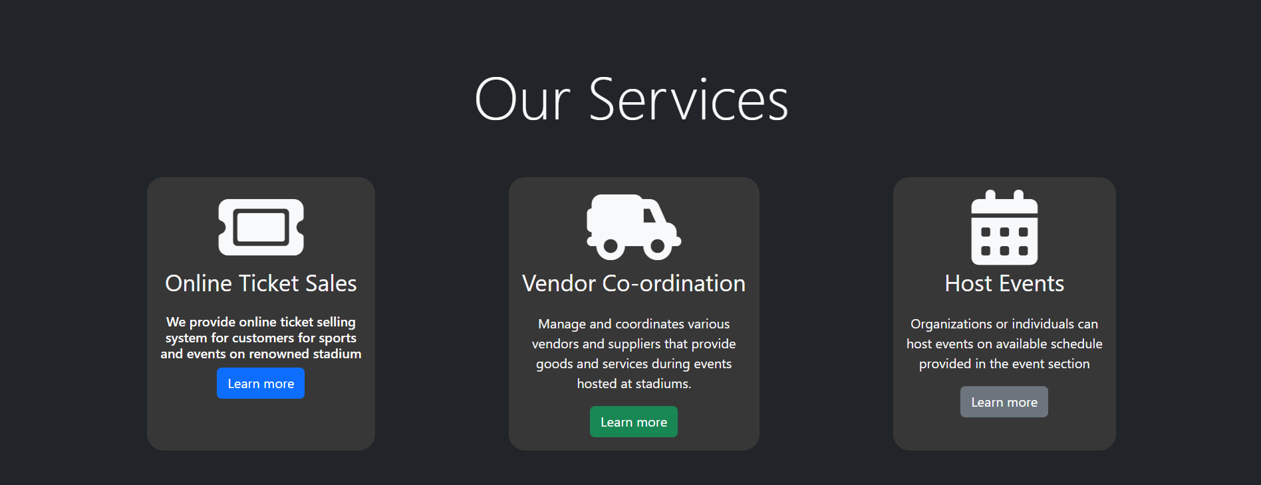
Our Objectives

Slide 9
Final Database Design

Slide 10
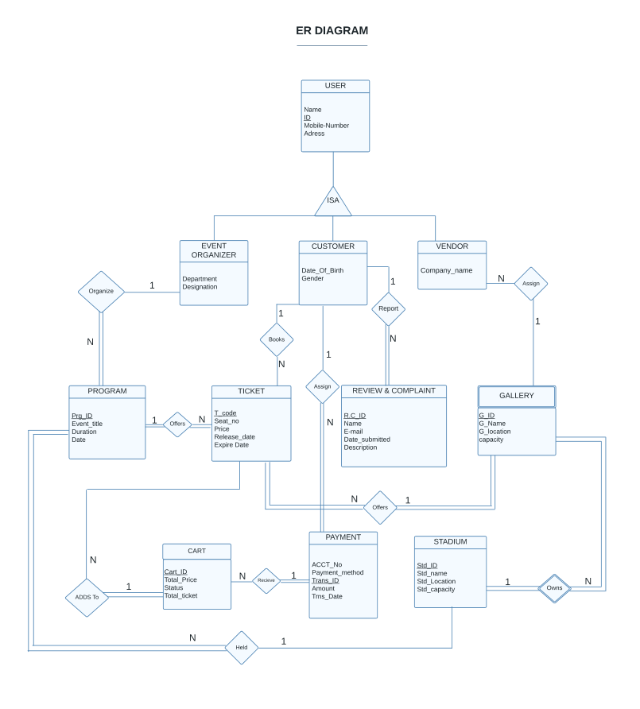
ER Diagram

Slide 11
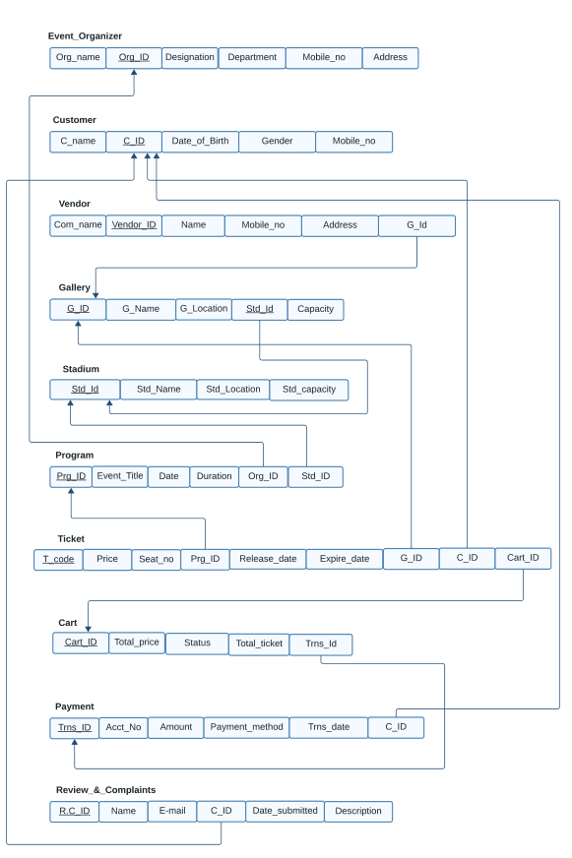
Relational Mapping

Slide 12
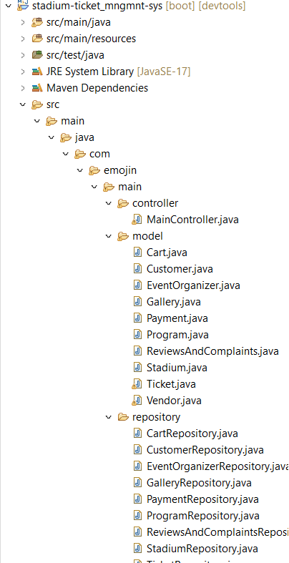
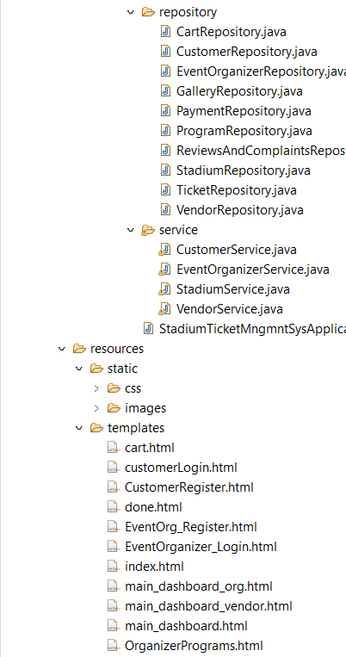
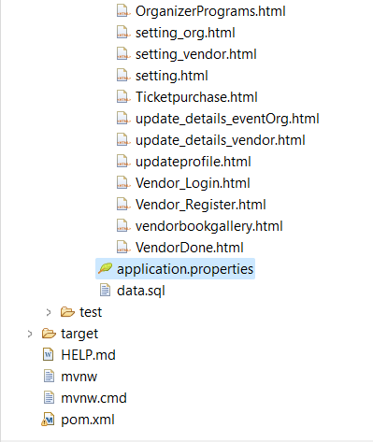

Slide 13
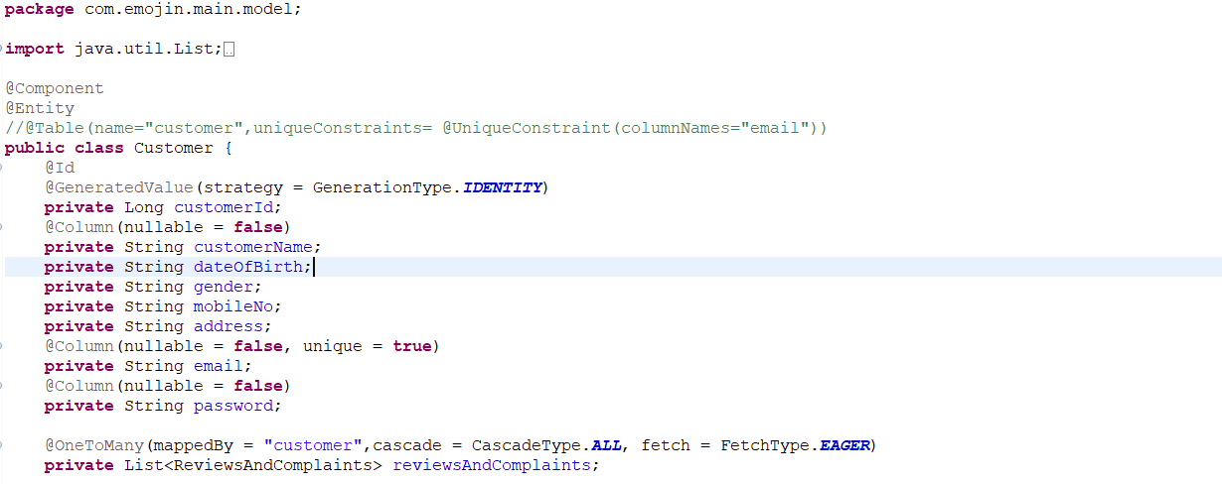
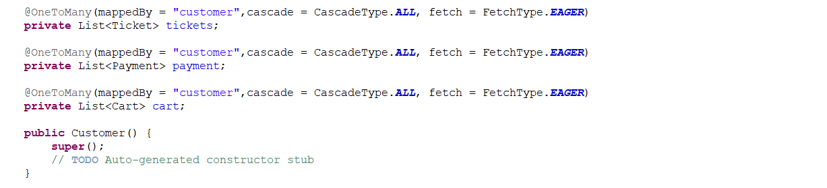
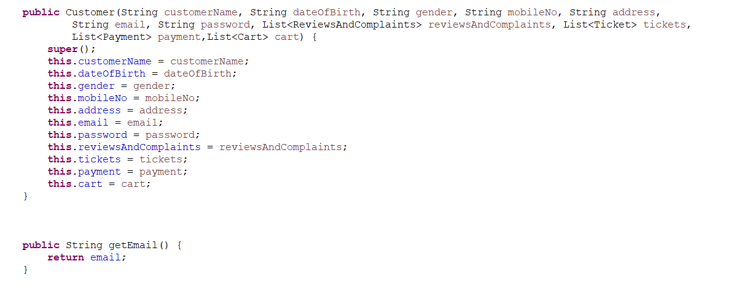

Slide 14
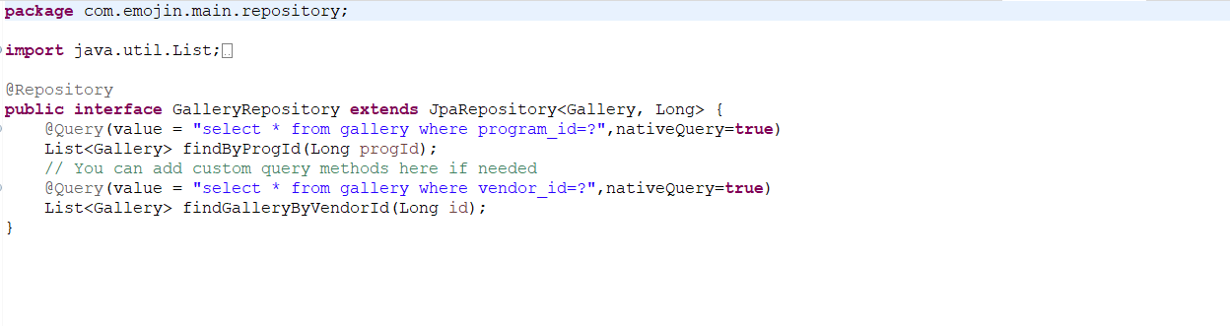

Slide 15
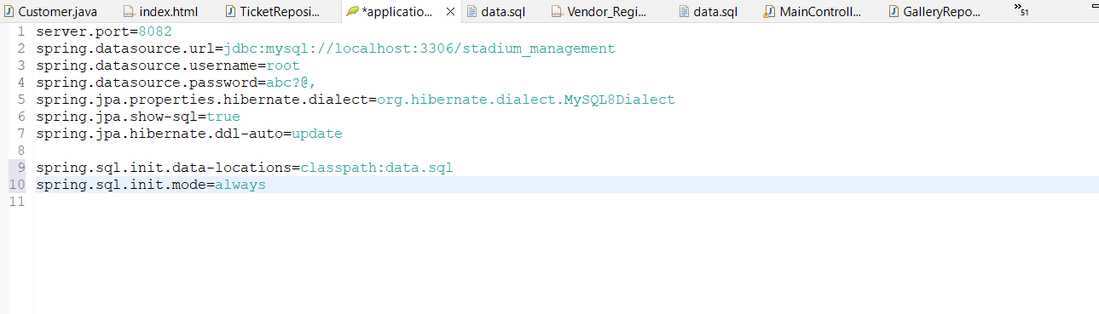

Slide 16
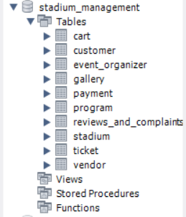
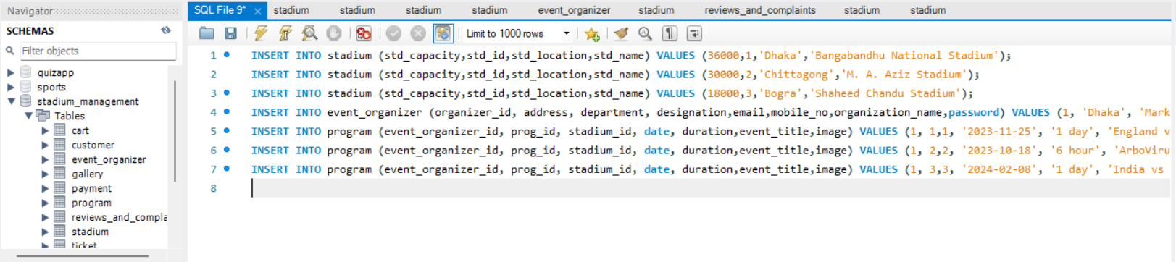

Slide 17
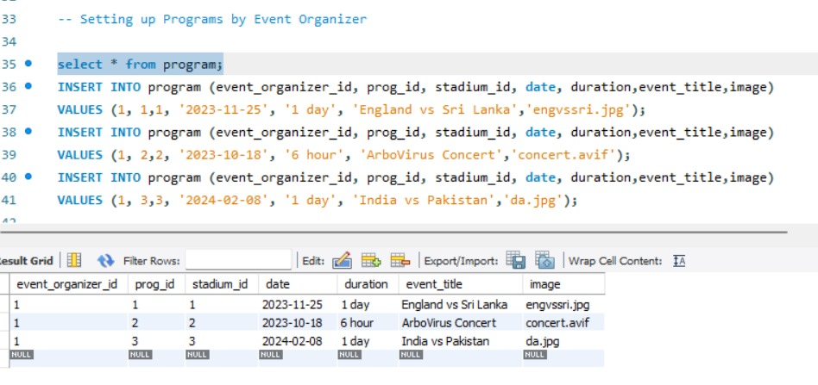
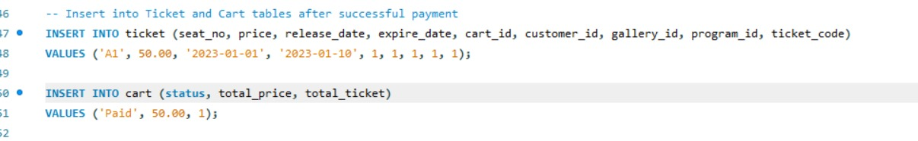

Slide 18
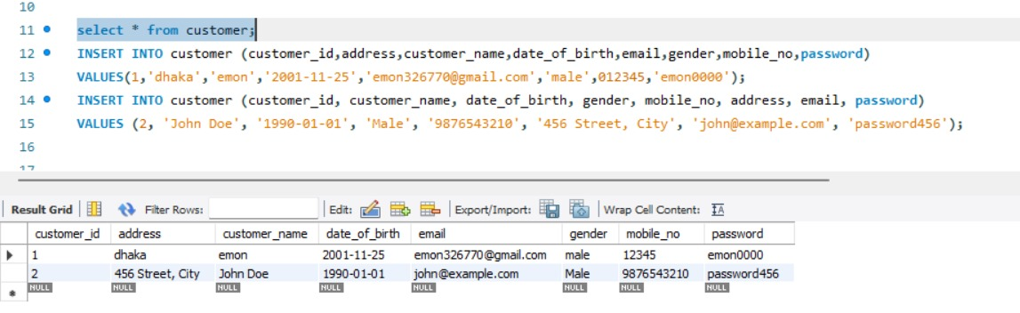

Slide 19
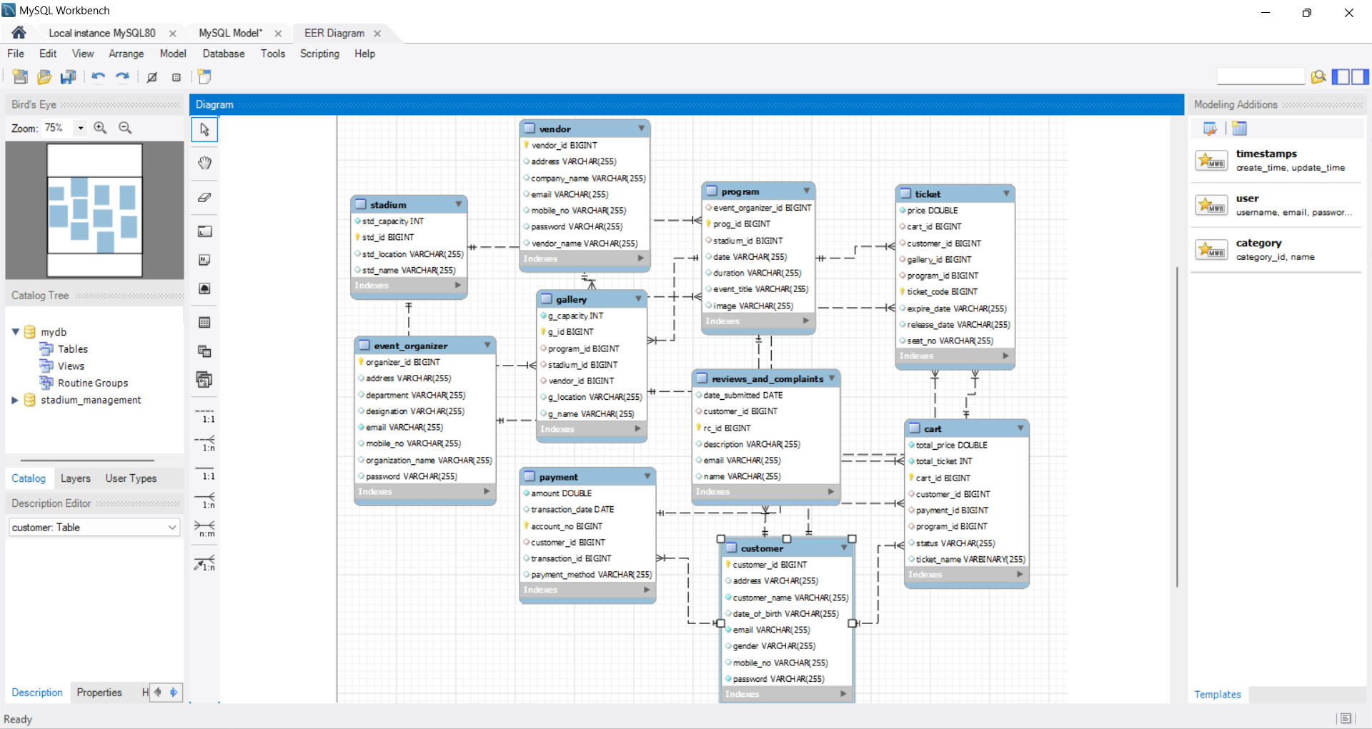

Slide 20
System Implementation

Slide 21


Slide 22
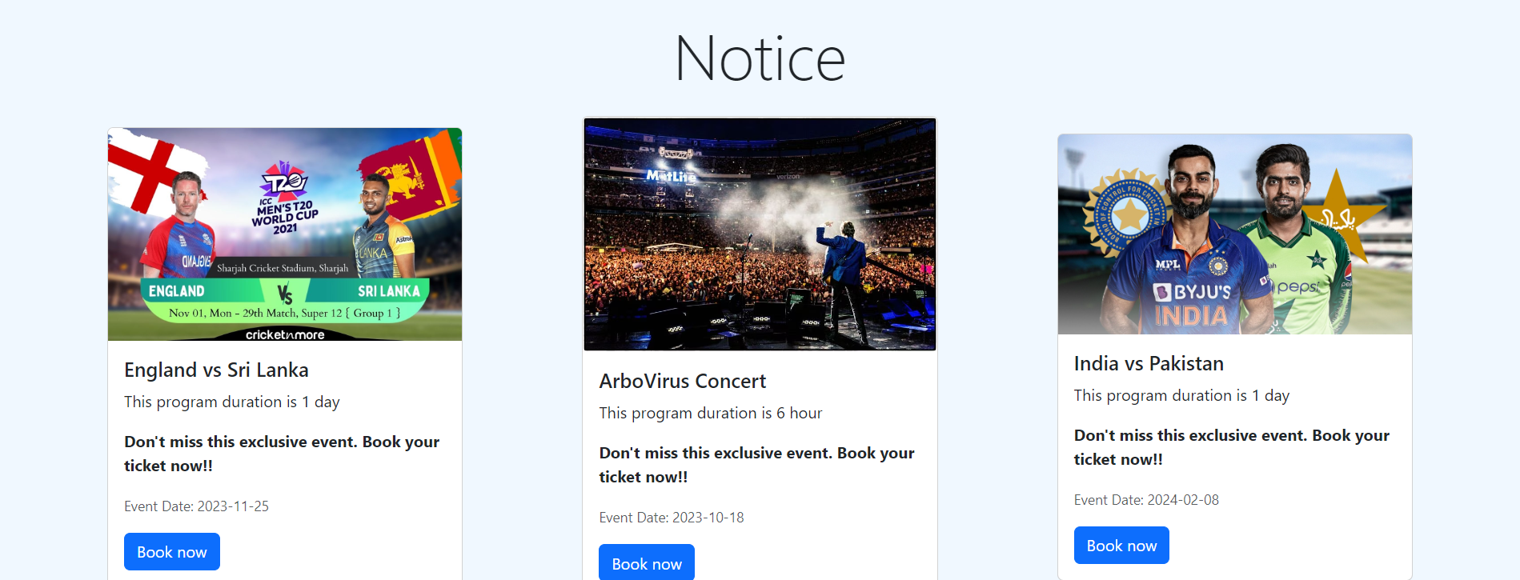
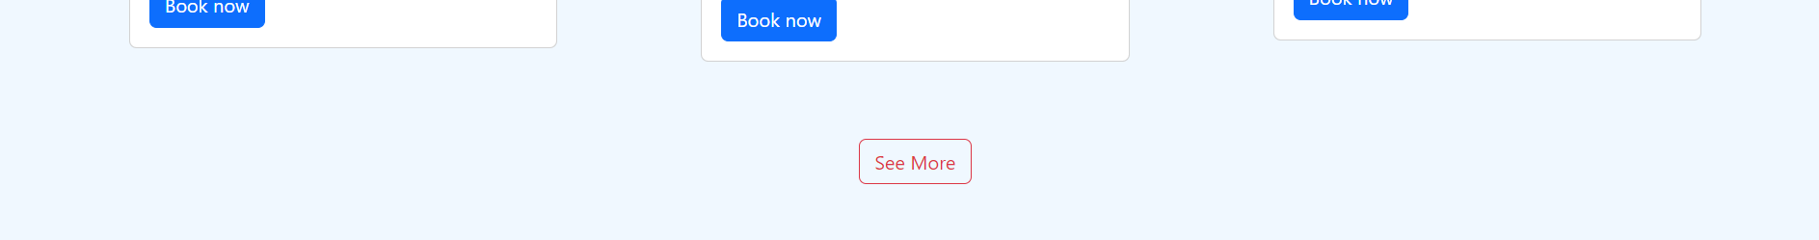

Slide 23
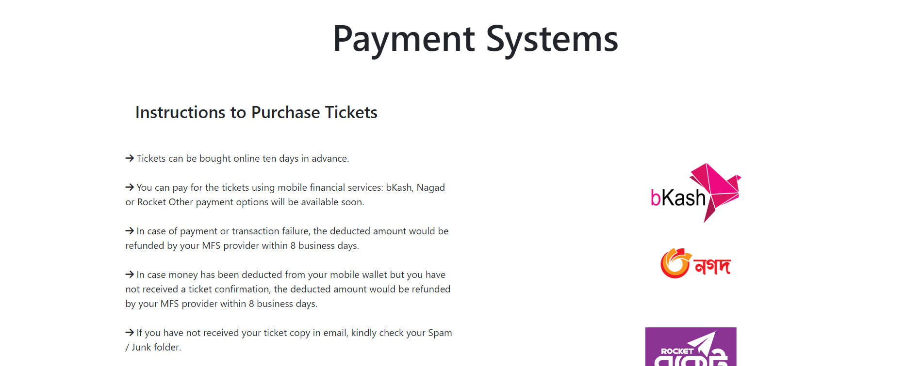
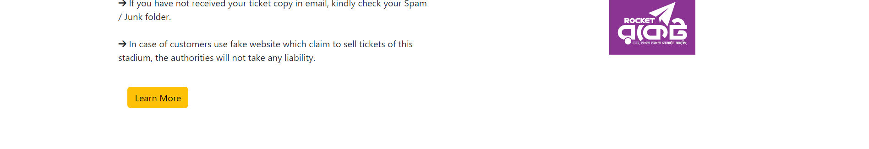

Slide 24
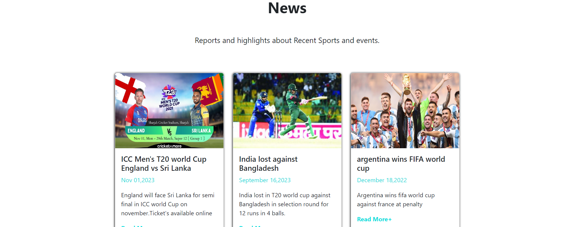


Slide 25
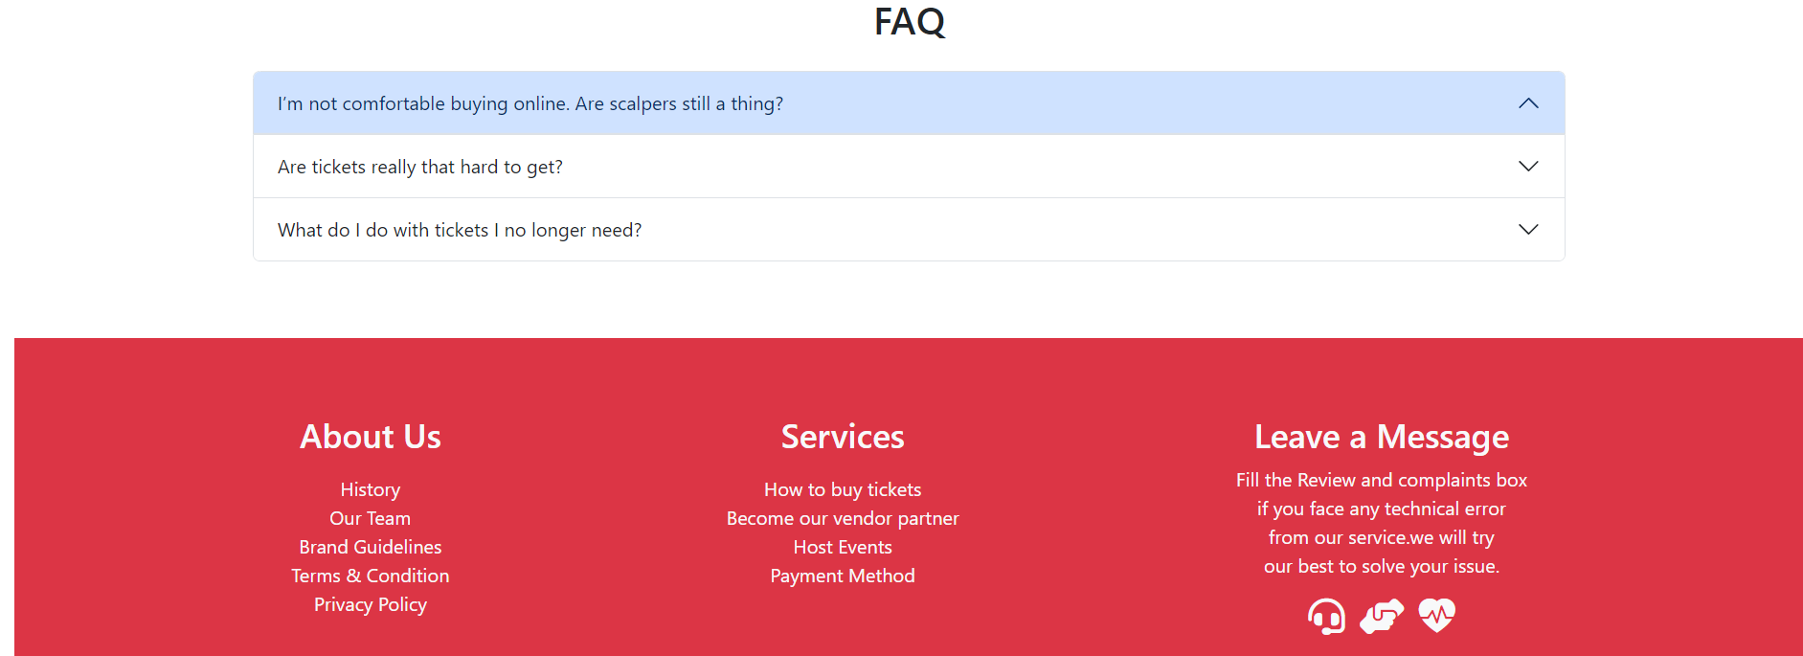

Slide 26
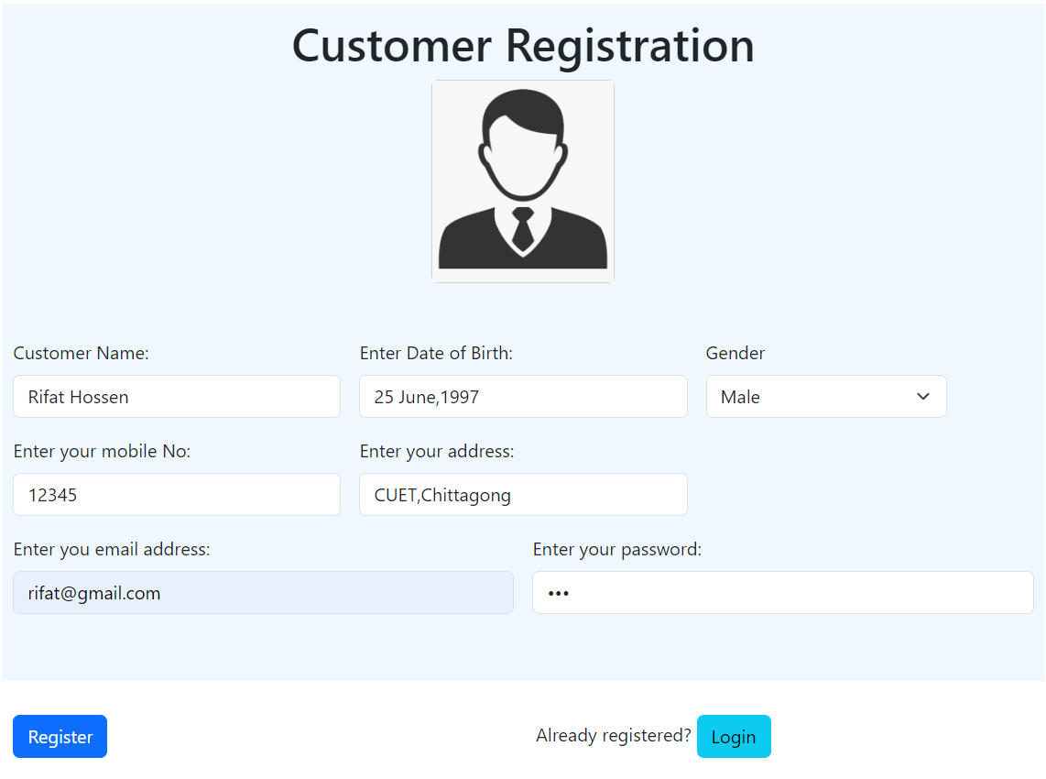

Slide 27
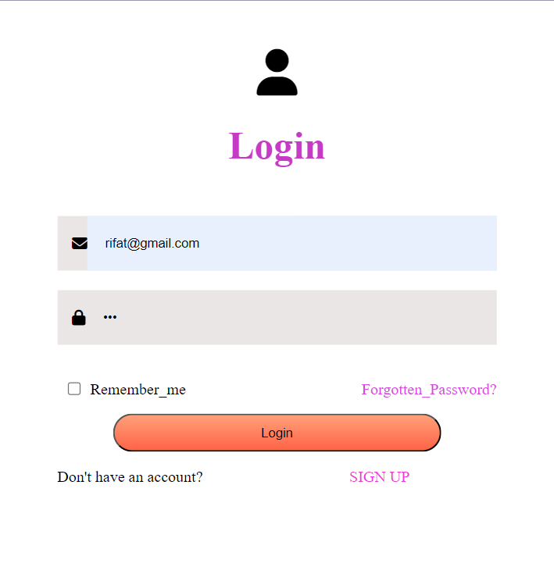

Slide 28
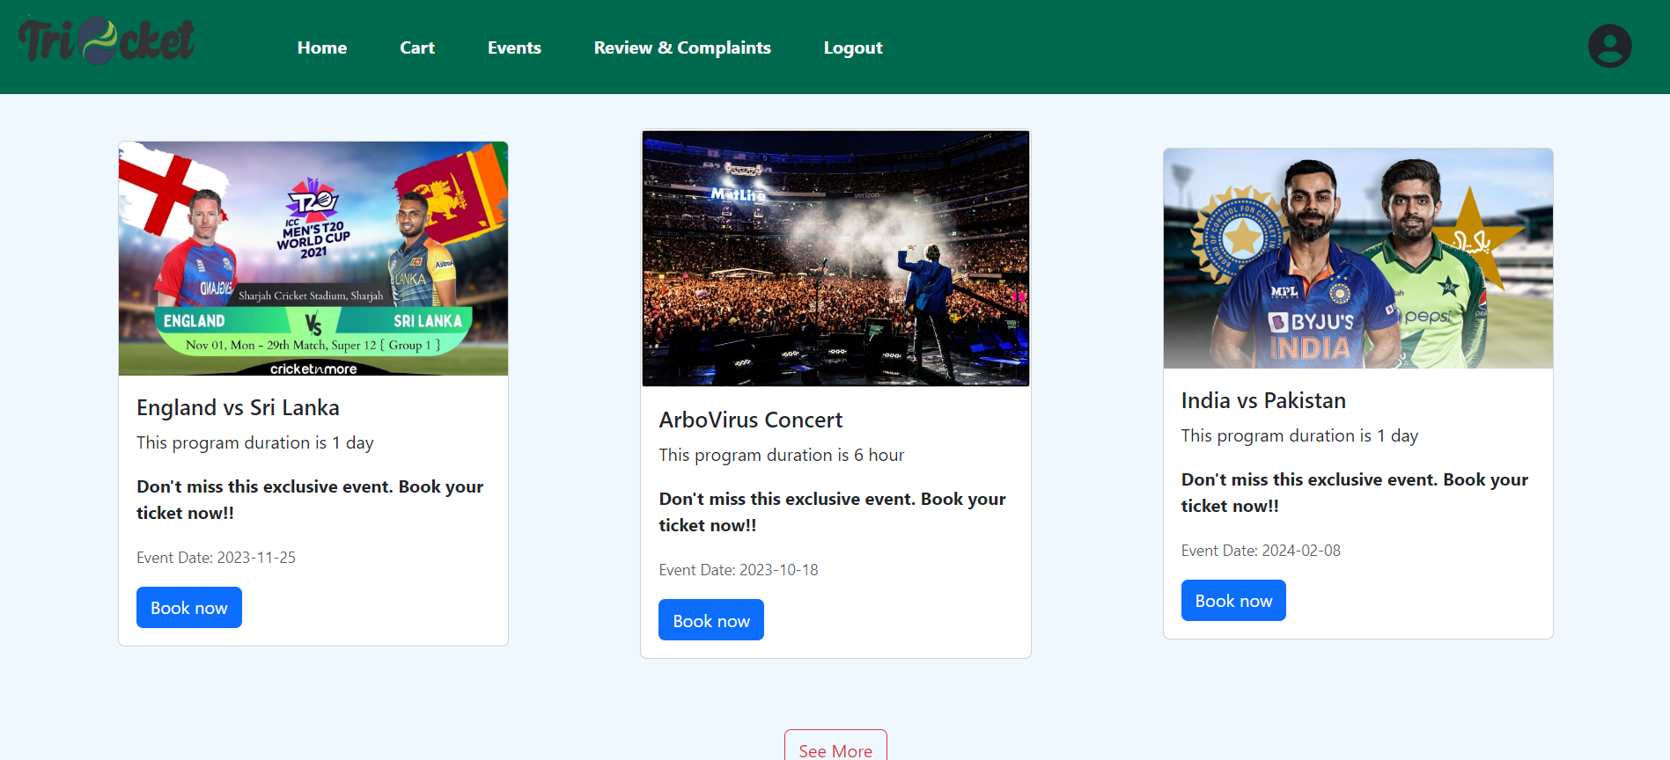

Slide 29
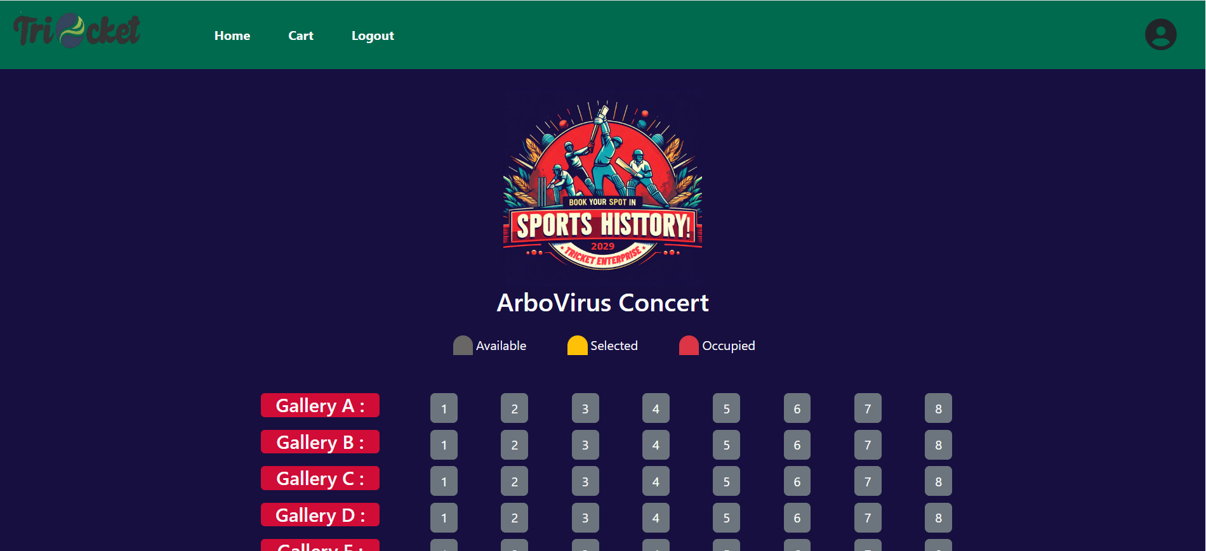


Slide 30
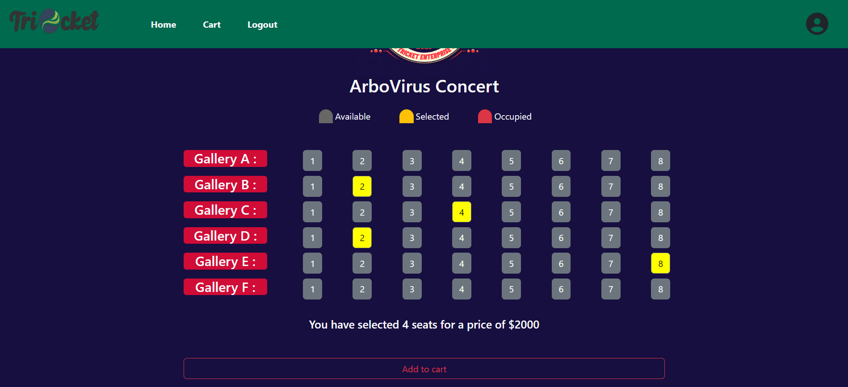

Slide 31
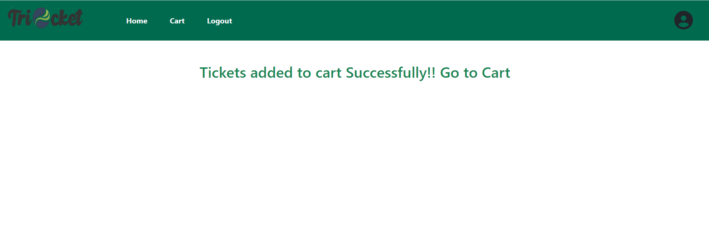

Slide 32
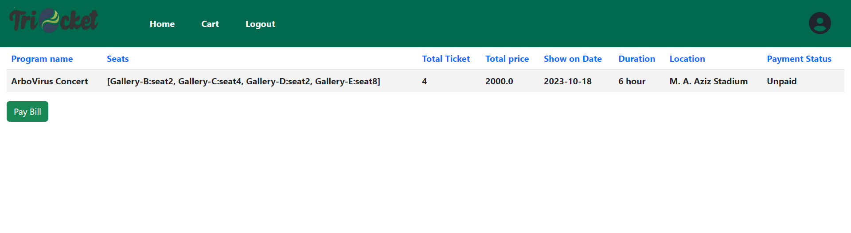

Slide 33
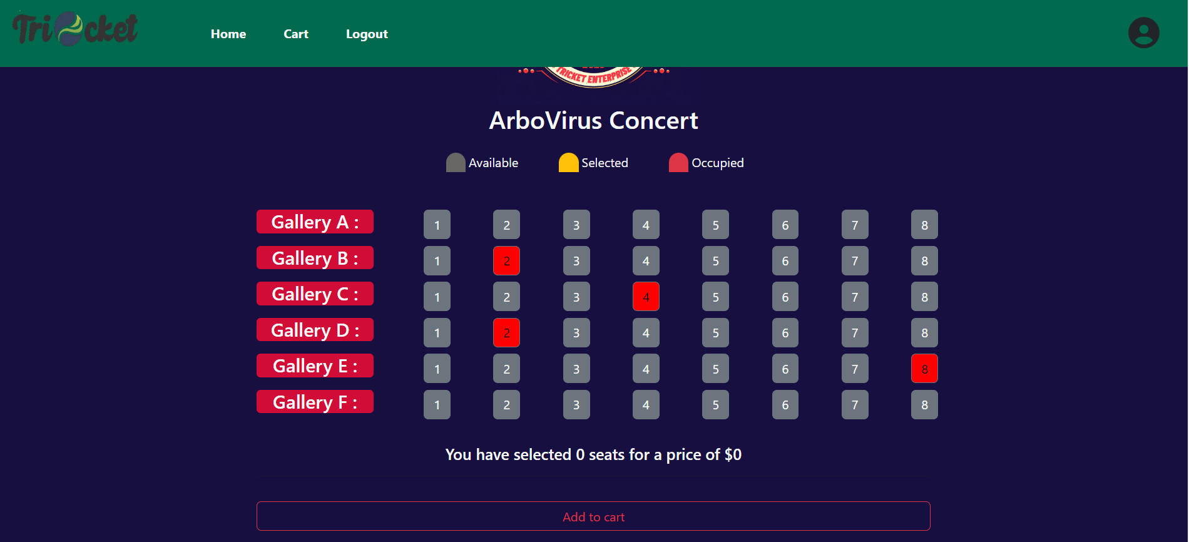

Slide 34
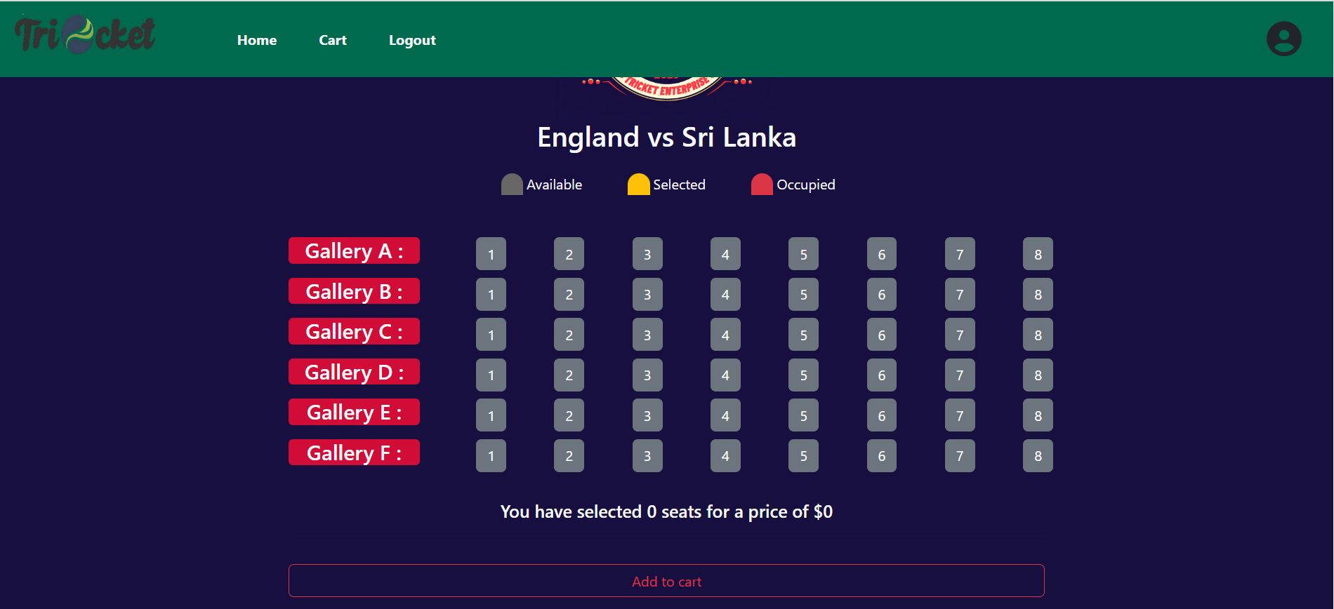

Slide 35
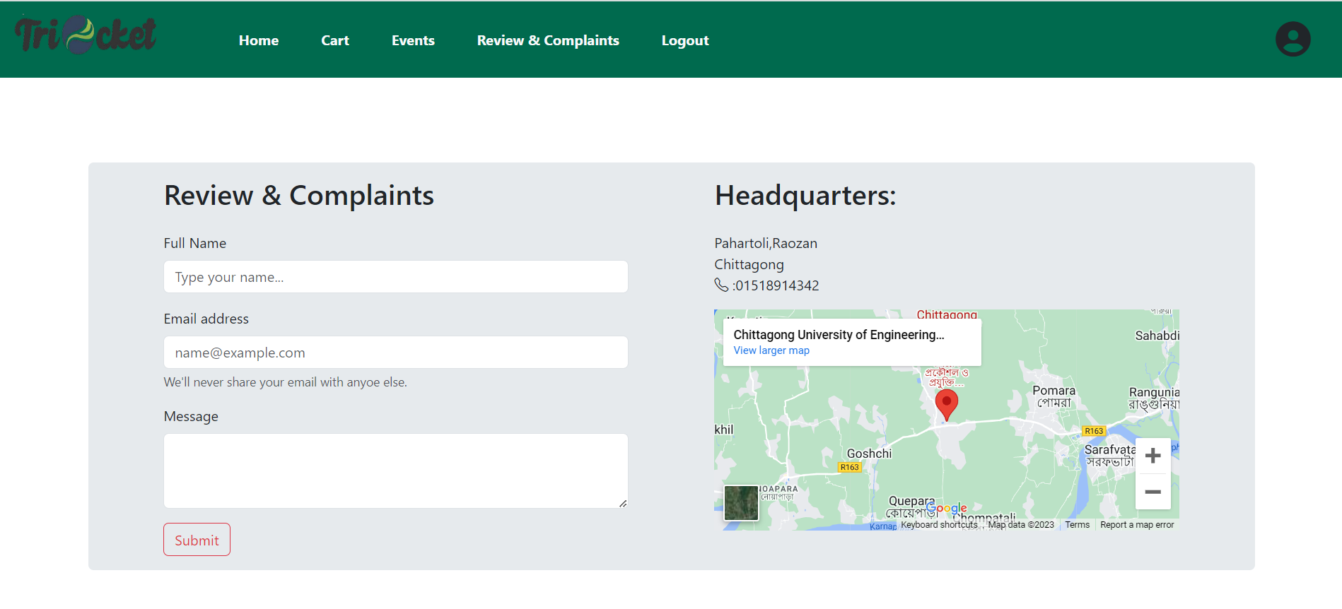

Slide 36
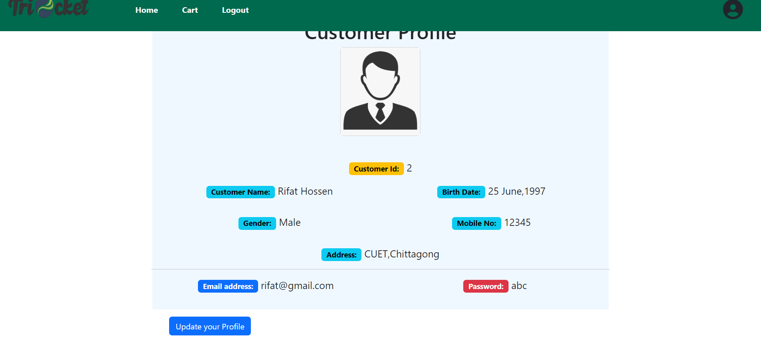

Slide 37
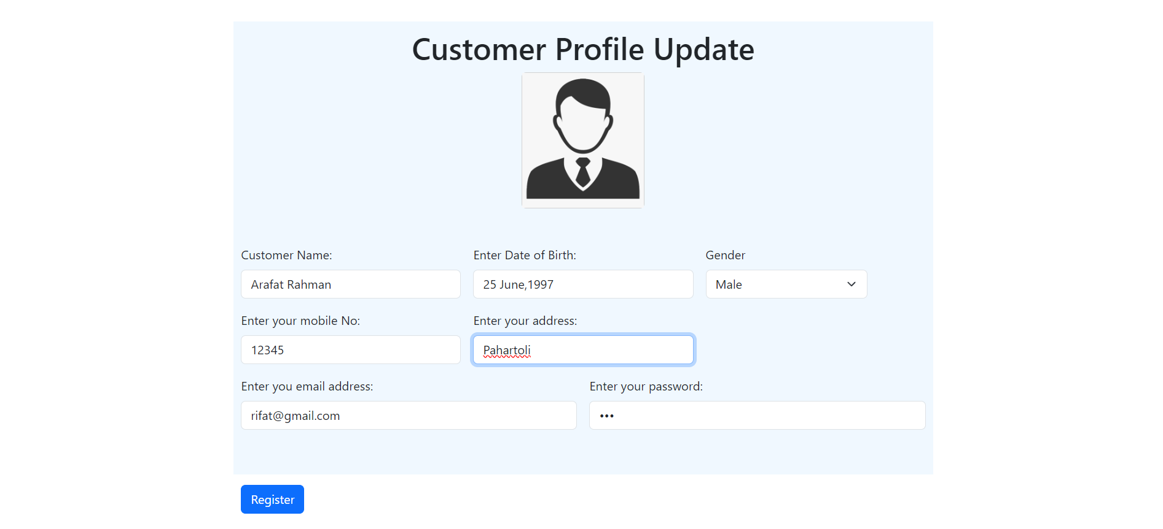

Slide 38


Slide 39
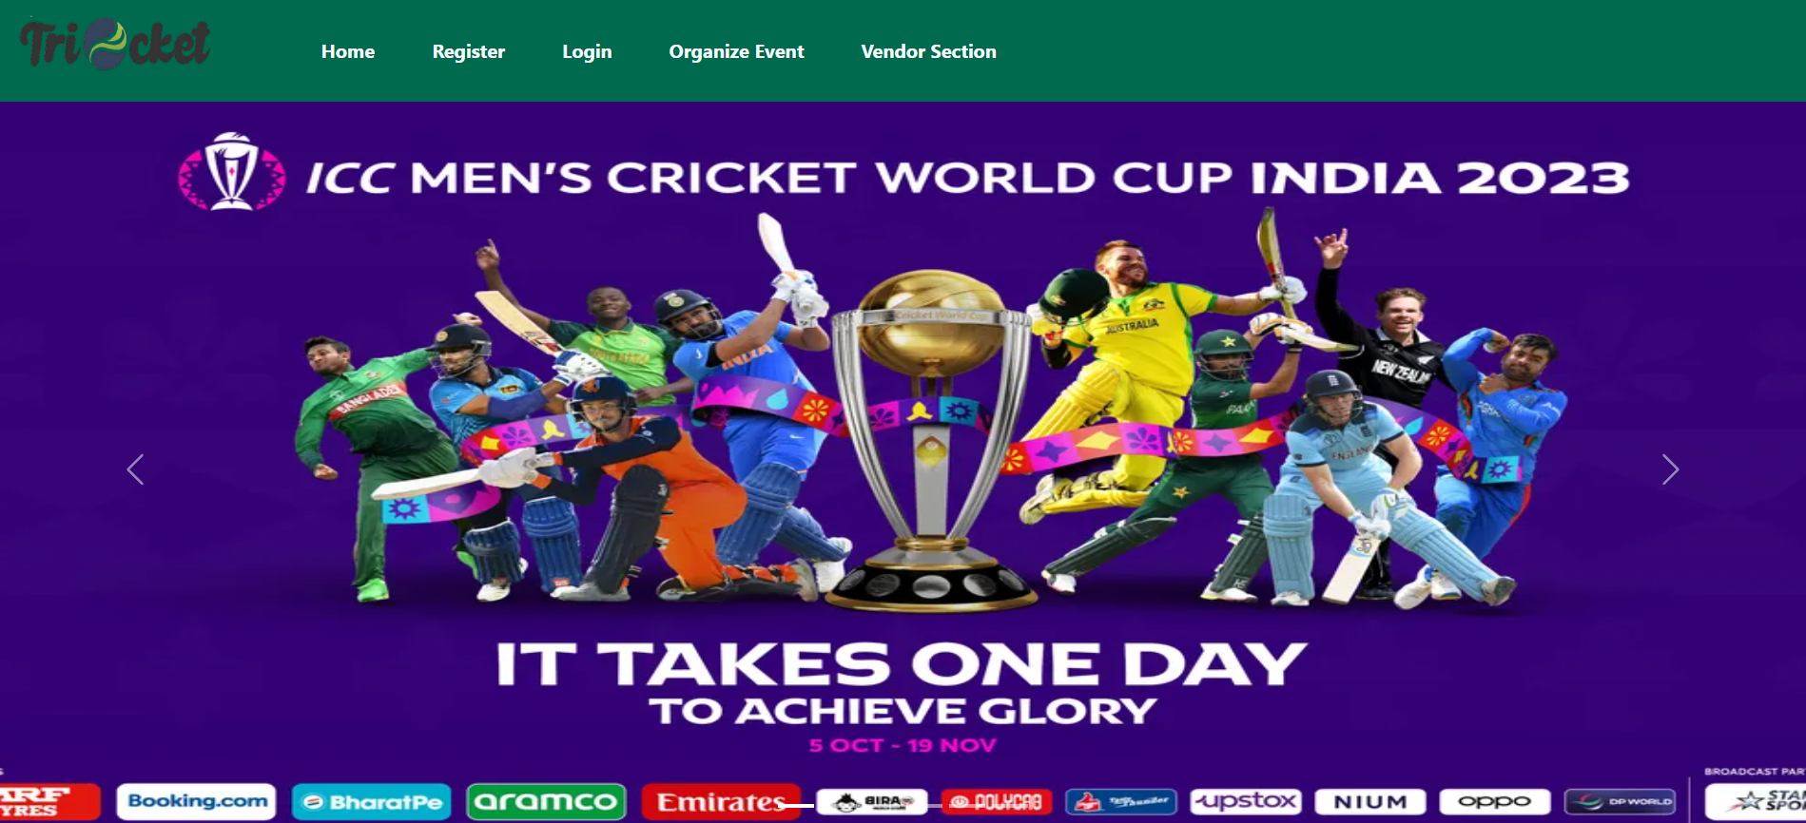

Slide 40
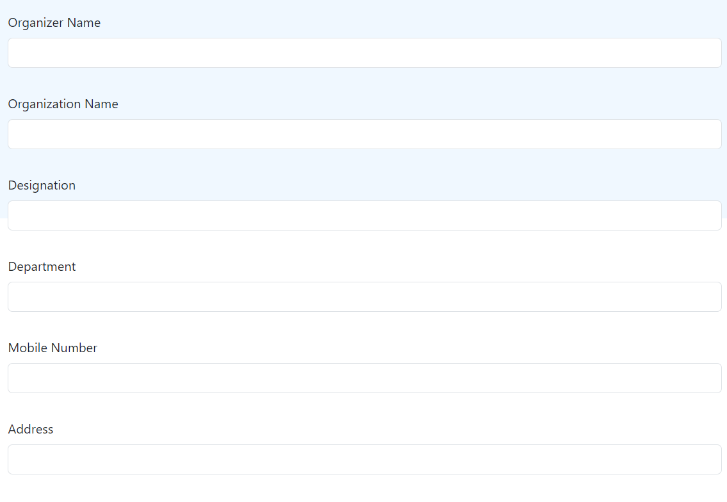
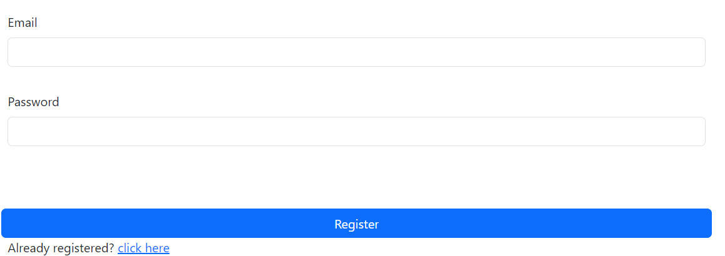

Slide 41
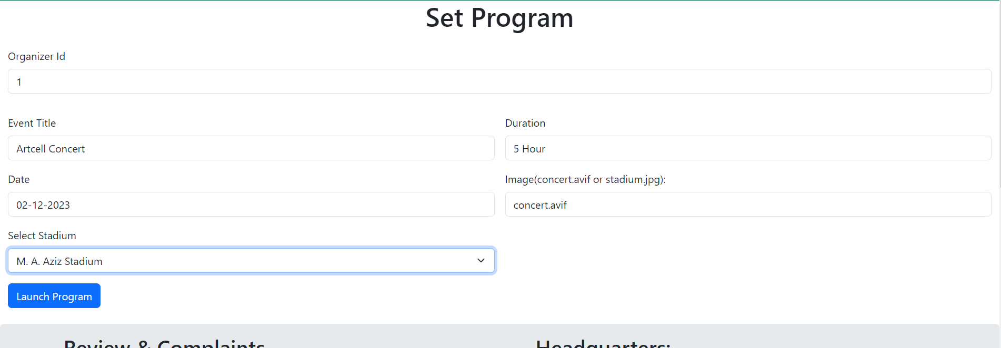

Slide 42
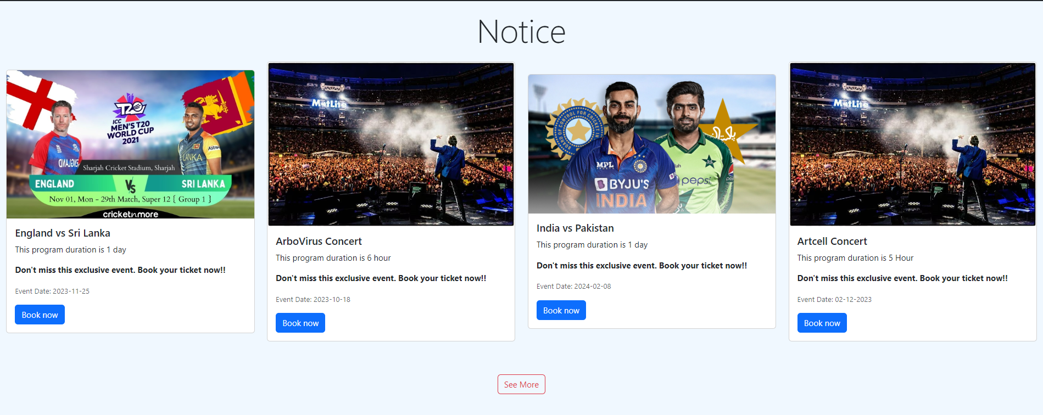

Slide 43
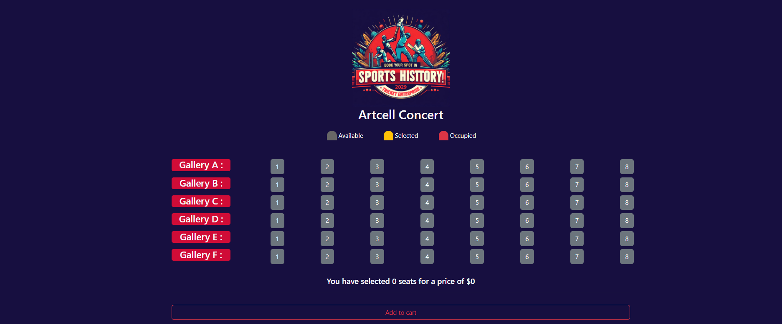

Slide 44
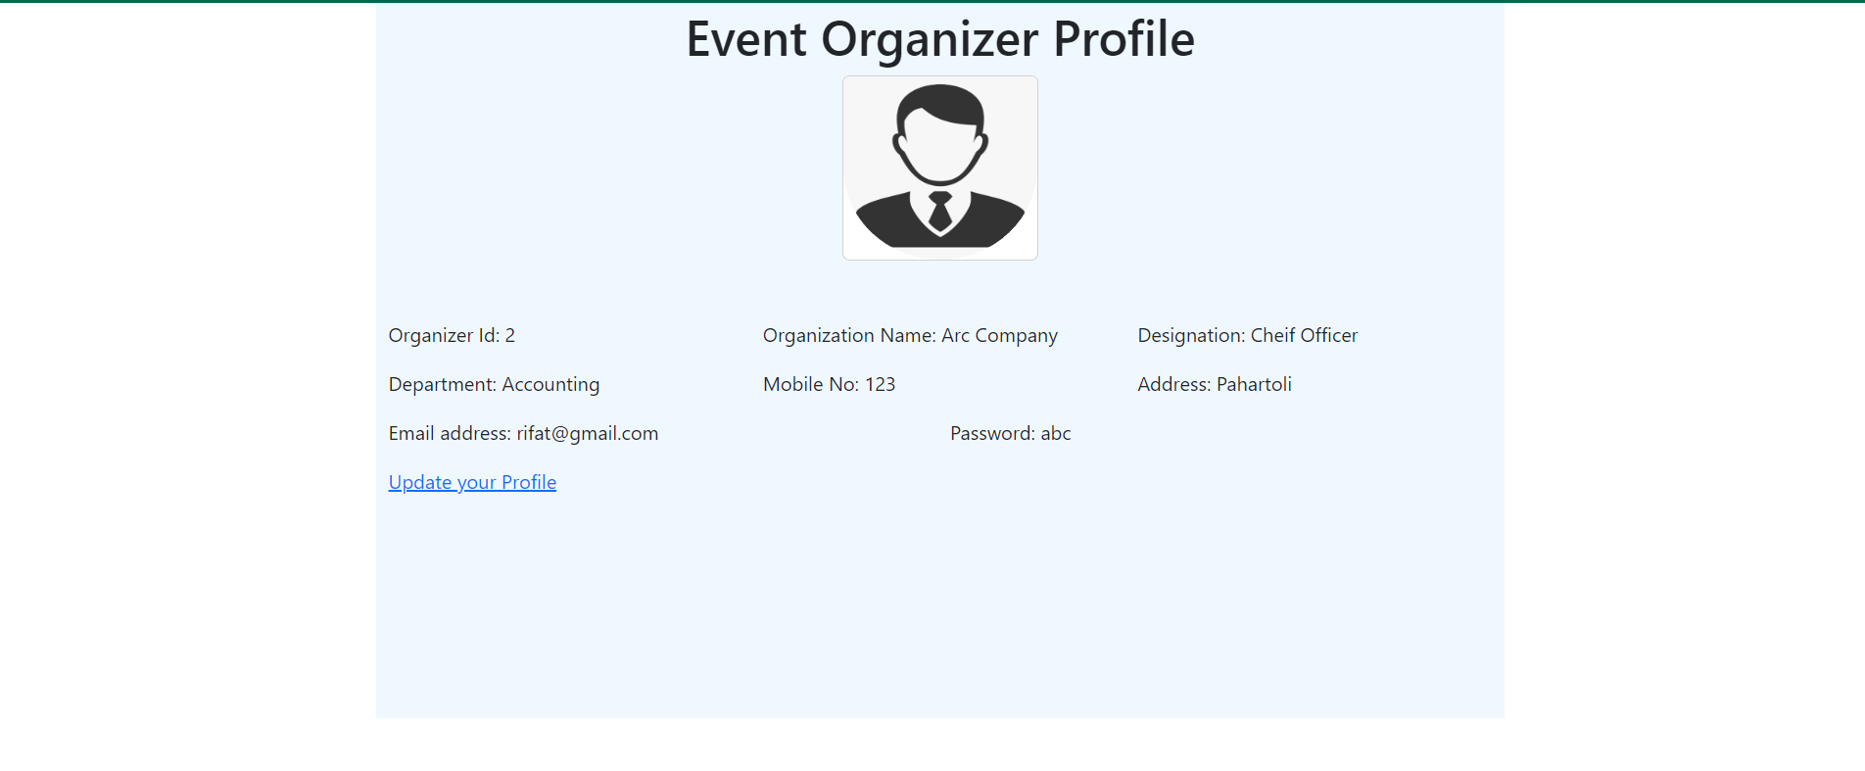

Slide 45
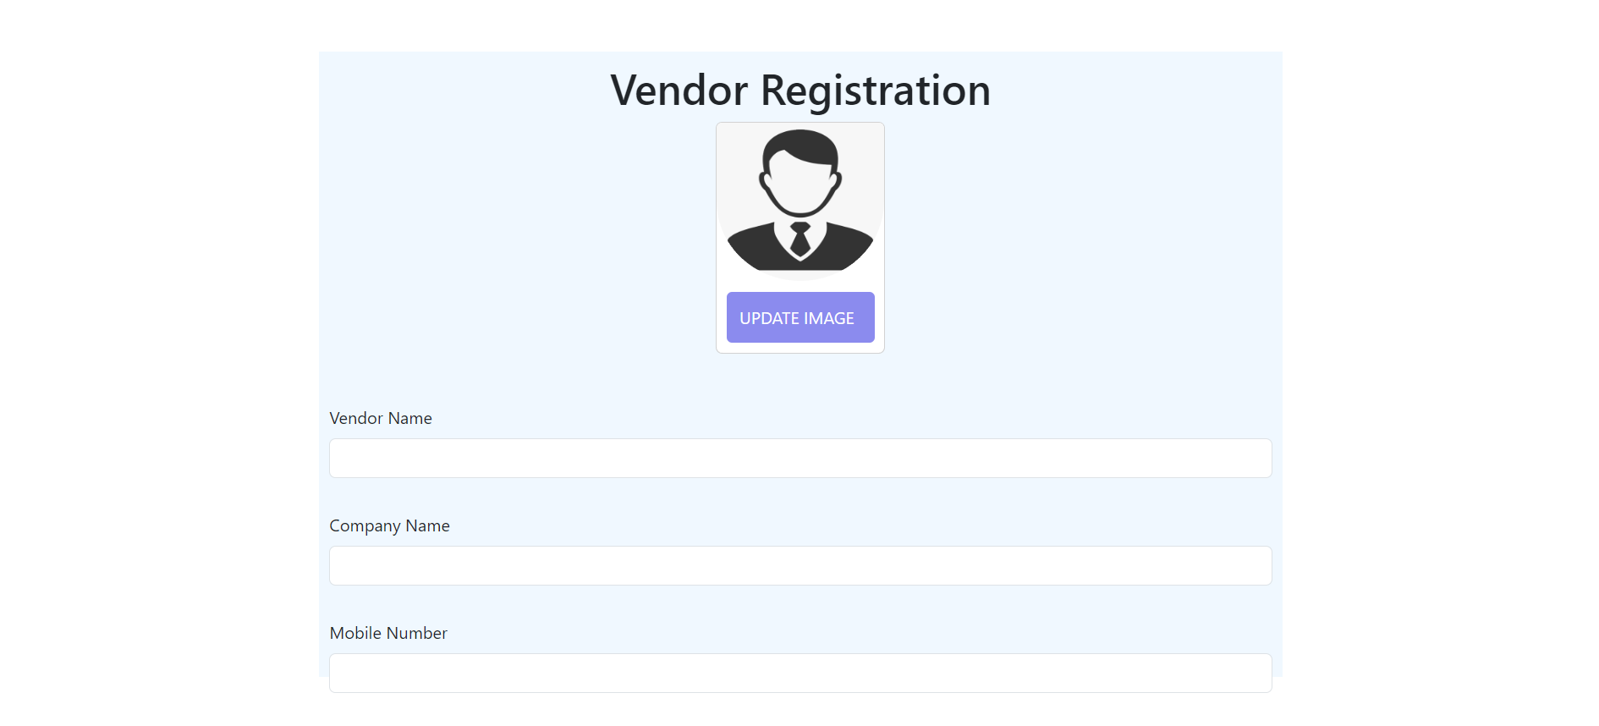

Slide 46
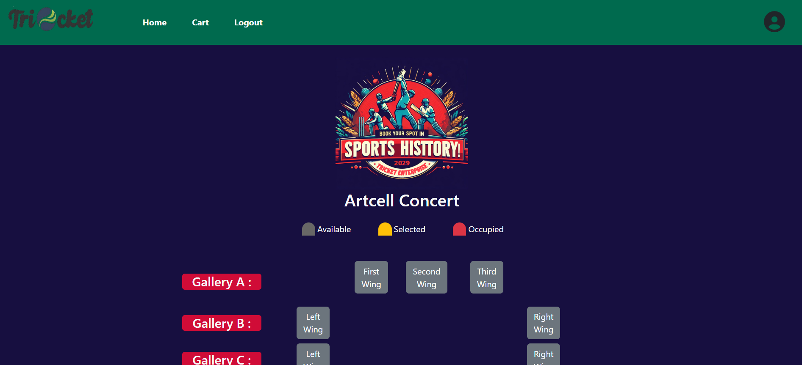
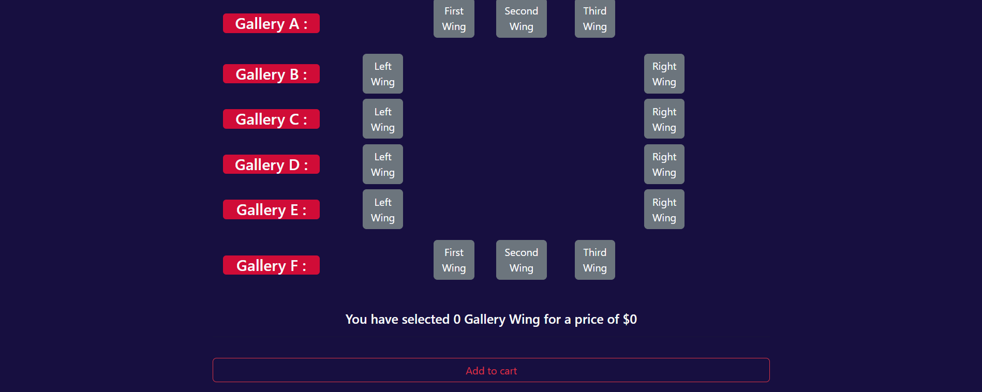

Slide 47
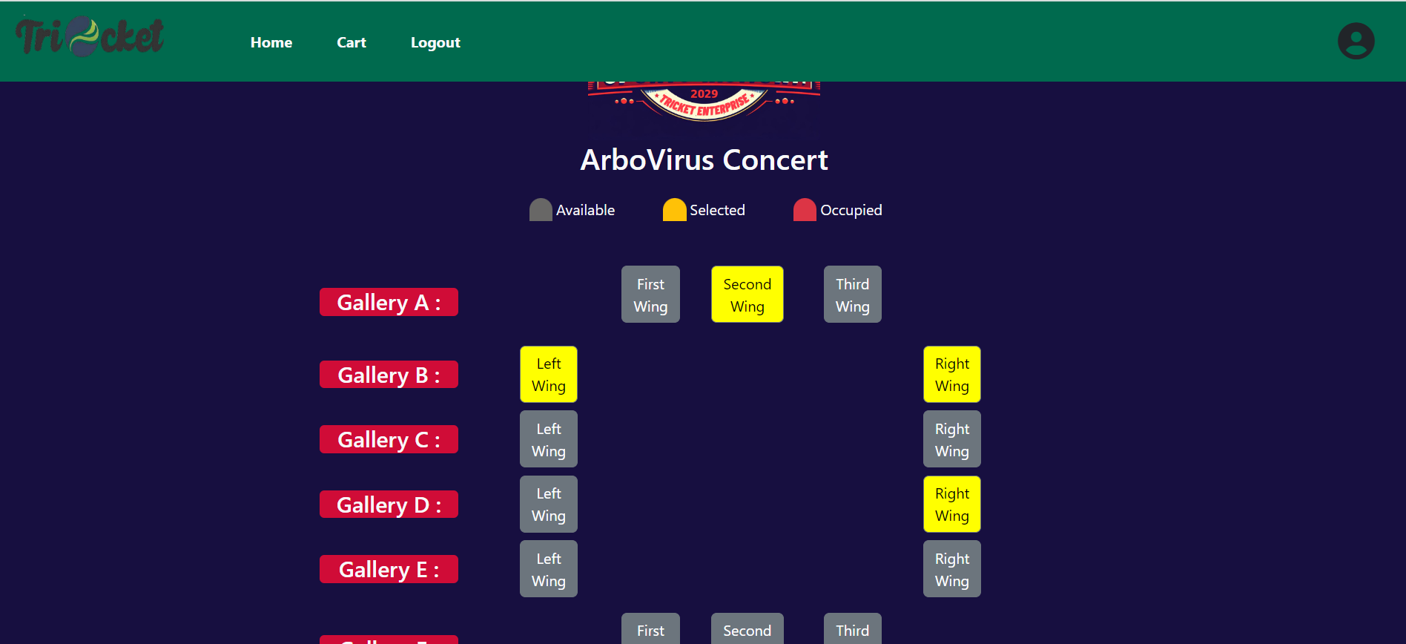

Slide 48
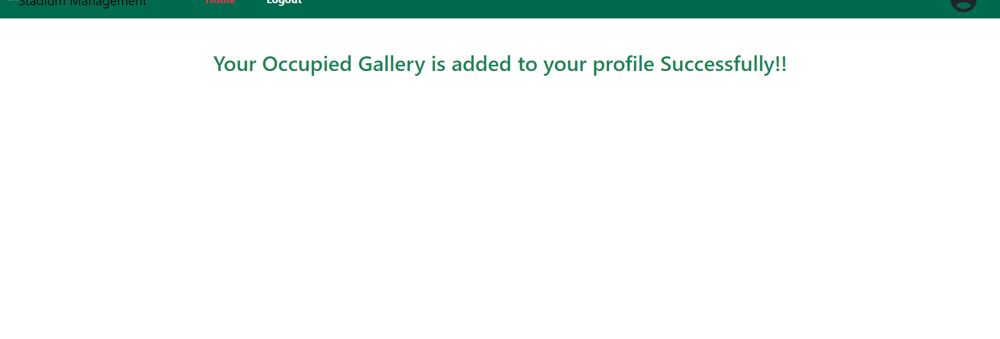

Slide 49
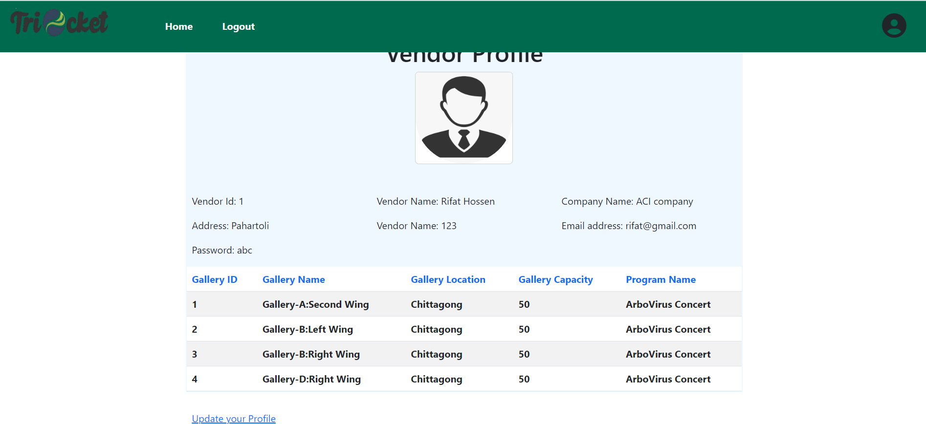

Slide 50
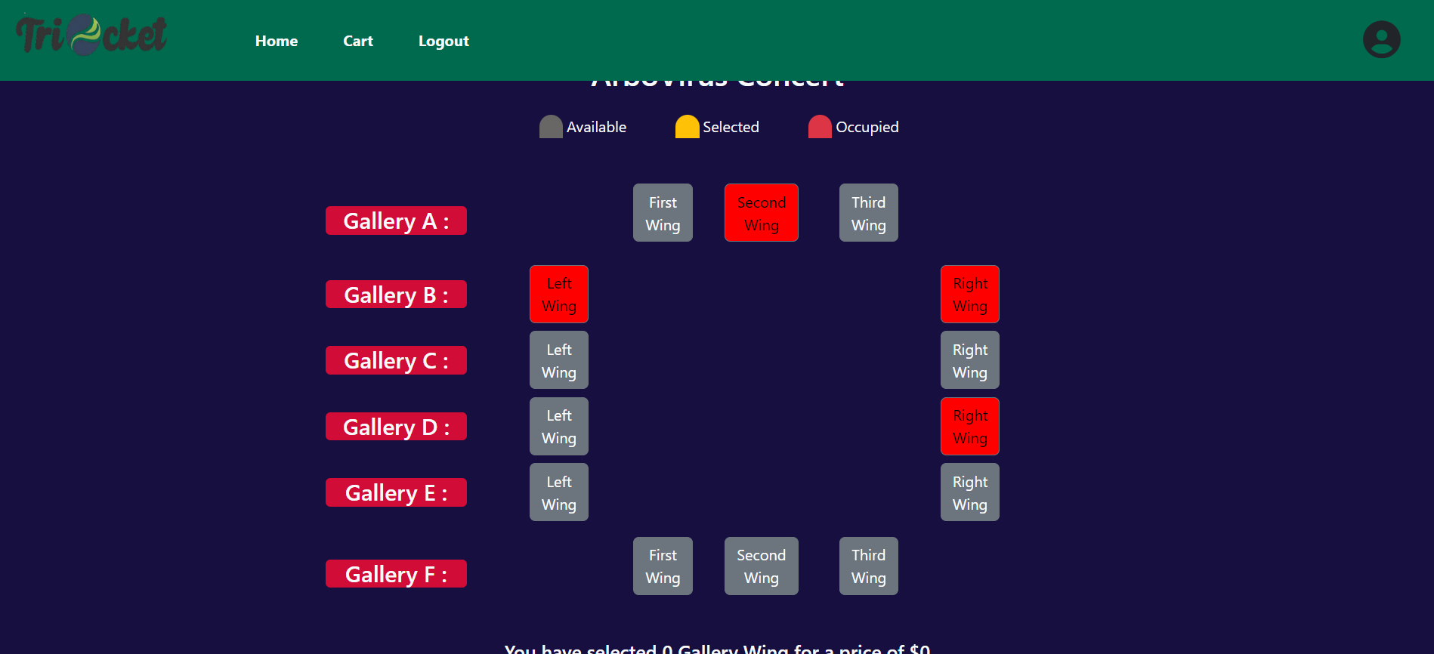

Slide 51
Conclusion
The Stadium and Ticket Management System project aims to revolutionize the management of stadium events, offering a comprehensive solution for event organizers and a seamless experience for attendees. We are confident that this system will significantly enhance the efficiency of stadium event planning and execution, enabling organizers to deliver exceptional experiences while providing attendees with a hassle-free and engaging event environment. We look forward to the opportunity to develop this innovative solution.

